Slide 1


UNIVERSITY INSTITUTE OF ENGINEERING
COMPUTER SCIENCE ENGINEERING
Bachelor of Engineering
Robotics Process Automation(20CST-472)
Prepared By: Mrs. Jyoti Chandel(E155800)
Topic :Evolution of RPA and RPA features
DISCOVER . LEARN . EMPOWER

Slide 2

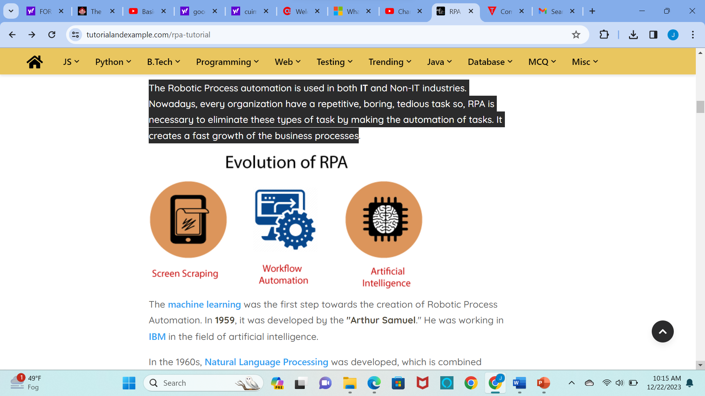
RPA History
The Robotic Process automation is used in both IT and Non-IT industries. Nowadays, every organization have a repetitive, boring, tedious task so, RPA is necessary to eliminate these types of task by making the automation of tasks. It creates a fast growth of the business processes

Slide 3
RPA History
The machine learning was the first step towards the creation of Robotic Process Automation. In 1959, it was developed by the "Arthur Samuel." He was working in IBM in the field of artificial intelligence.
In the 1960s, Natural Language Processing was developed, which is combined artificial intelligence with the interactions between computers and human beings.
In the early 1990s, Artificial Intelligence was taken over by many industries, especially for manufacturing companies. But its implementation within the financial sector has suddenly decreased because of its costs and implementation problems. This was when Natural Language Processing came in the IT industries.

Slide 4
RPA History
The primary purpose of NLP (Natural Language Process) was to help the computer to understand and process the human language more accurately. The Machine Learning and Natural Language processing both can be seen in the Robotic Process Automation.

Slide 5
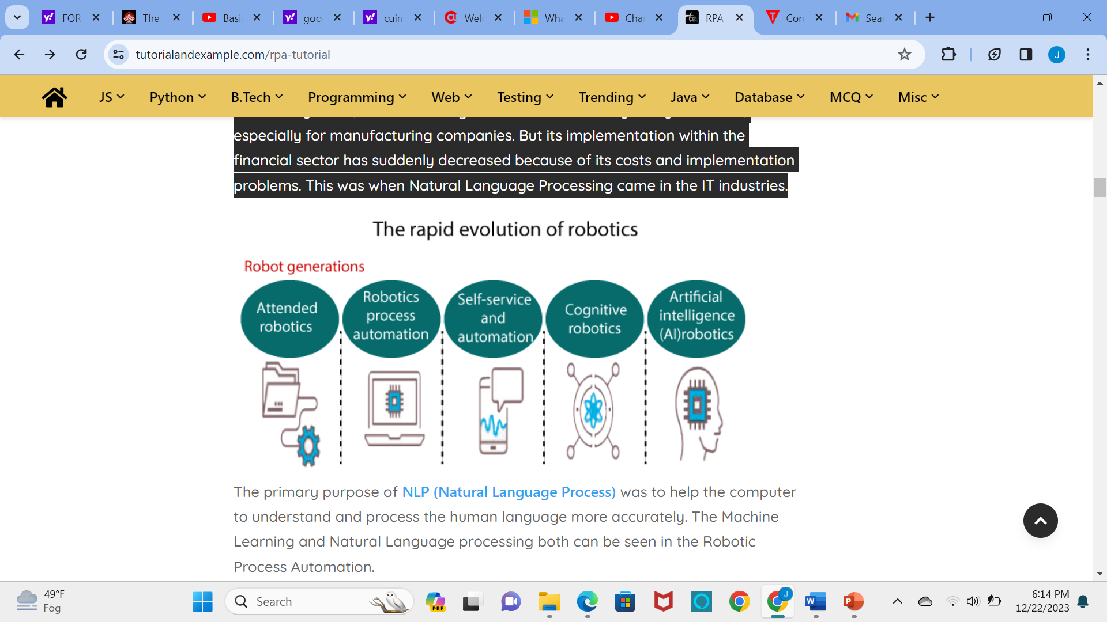
EVOLUTION OF ROBOTICS

Slide 6
RPA Component
The components of RPA have together build a platform, which can automate any repetitive task. Robotic Process automation is beneficial for the reusability within the systems, simplify changes, etc.
It has focused on the business rules without any need to create the links. The RPA is also beneficial to the target application integration, which can be changed without the risk of changing business rules.
In the field of Robotic Process Automation, the development does not require the understanding of business rules.

Slide 7
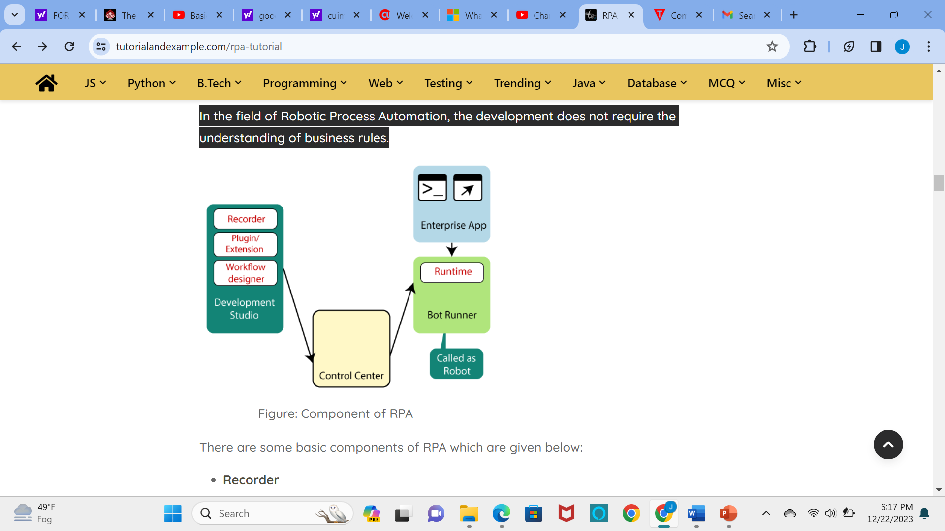
RPA Component

Slide 8
There are some basic components of RPA which are given below:
Recorder
The UiPath’s recorder is used to record the UI mouse movements and keyboard activities to generate automation scripts.
These recorded activities are generated as per sequence or well maintained in increasing order. The recorder can also be used to playback the recorded actions.
Development Studio
The Development Studio or UiPath studio is used to create or develop the automation workflows by which we can automate the task easily.

Slide 9
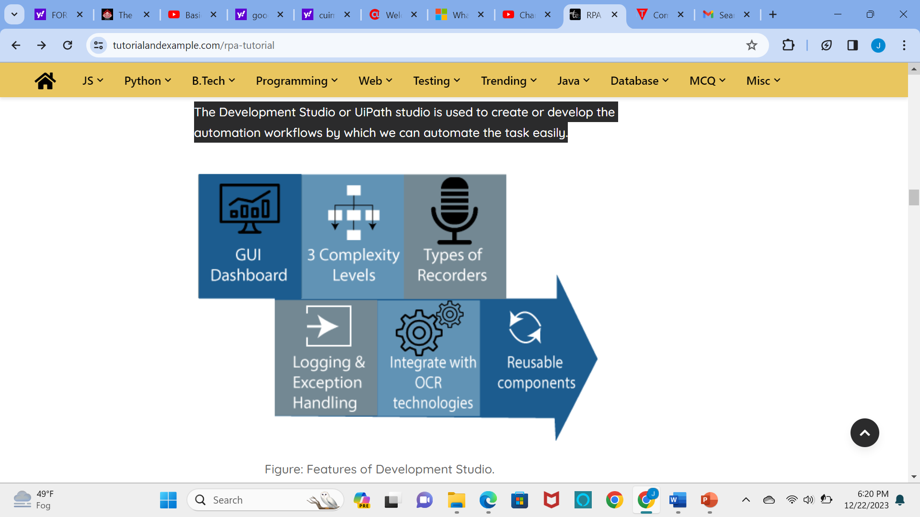
Features of Development studio

Slide 10
RPA Features
Artificial intelligence and cognitive intelligence are two common features of RPA. Both features are involved in machine learning, computer vision, and cognitive automation to help the bots for improving the decision making over the period.
There are some unique features of RPA which are given below:
1. Rich Analytical suit: The Rich Analytical suit is used to discover the performance of the robot workforce. It manages and monitors the automated functions from the central console in RPA.
2. Security: The RPA tools include role-based security, which ensures the action-specific permissions. Some Robotic Process Automation tools enable the configuration as well as customization of encryption capability to secure a specific data type against the interruption of network communication.

Slide 11
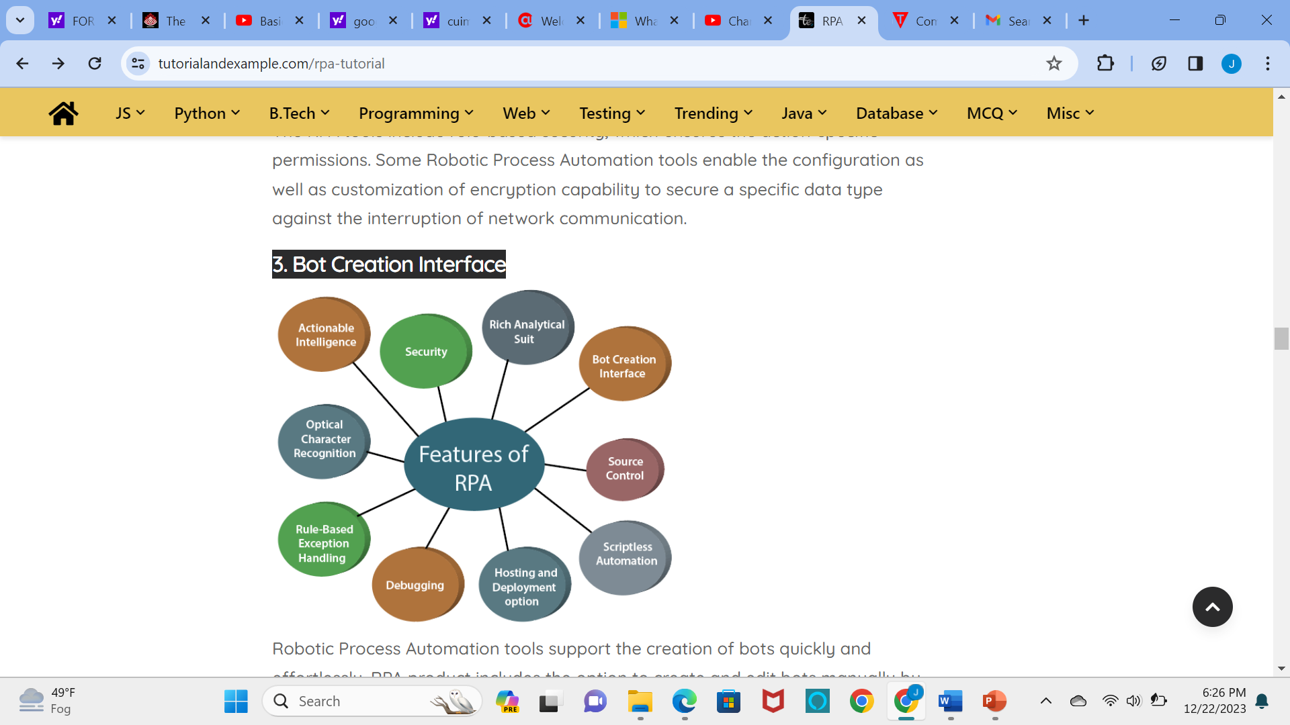
RPA Features
3. Bot Creation Interface
Robotic Process Automation tools support the creation of bots quickly and effortlessly. RPA product includes the option to create and edit bots manually by using the Task Editor.

Slide 12
RPA Features
4. Source Control
The Source Control method allows developers to examine the difference between versions of a particular process to discover what has changed.
5. Hosting and Deployment Option
RPA supports customer deployment across virtual machines, terminal services, and cloud. As compared to other deployment options, cloud deployment attracts most of the customers for its scalability and flexibility.
6. Rule-Based Exception Handling
The Robotic Process Automation allows deployment with the rule-based exception handling. This feature of RPA proactively handles the exception.
7. Debugging
Few RPA tools should stop running to make the change and replicate the process. Other RPA tools allowed dynamic interaction at the time of debugging. Debugging is a very important feature of RPA.

Slide 13
RPA Features
8. Scriptless automation
The RPA tools are code-free and may automate the application of any department. The employee or user with less programming skills can also create the bots.
9. Seamless Integration
This feature of RPA is mainly used for the optimization of the user's software infrastructure to fit into the purpose of achieving data management and enterprise decision making.
10. Optical Character Recognition
The optical character recognition in the RPA is a new trend nowadays. Screen Scraping is the most standard feature of the RPA tool, which deals with the capturing of bitmap data from the system screen and cross-check it against cross details.

Slide 14
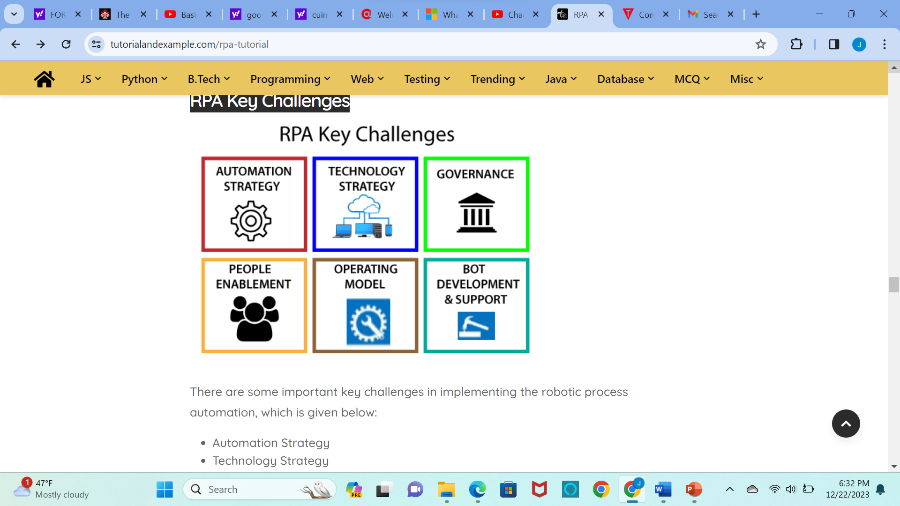
RPA Key Challenges

Slide 15
REFRENCE
https://www.tutorialandexample.com/rpa-tutorial

Slide 16
THANK YOU

